Slide 1
inversion, visualization, and open-source tools
Lindsey Heagy
University of British Columbia – Geophysical Inversion Facility

Slide 2
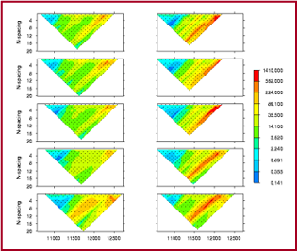
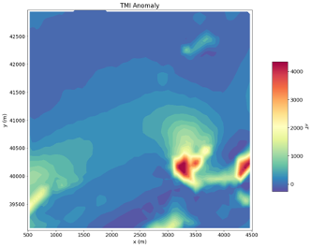
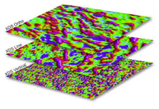
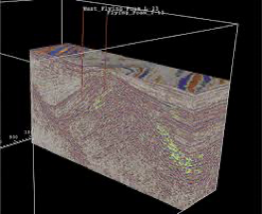
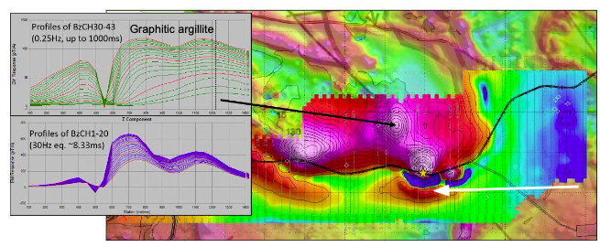
geophysical data
pseudosections (DC, IP)
multiple maps, volumes (EM, seismic)
maps (mag, grav, ….)
profiles, timeseries (EM)

Slide 3
geophysical data
pseudosections (DC, IP)
multiple maps, volumes (EM, seismic)
maps (mag, grav, ….)
How do we use these data to answer our geologic questions?
profiles, timeseries (EM)

Slide 4
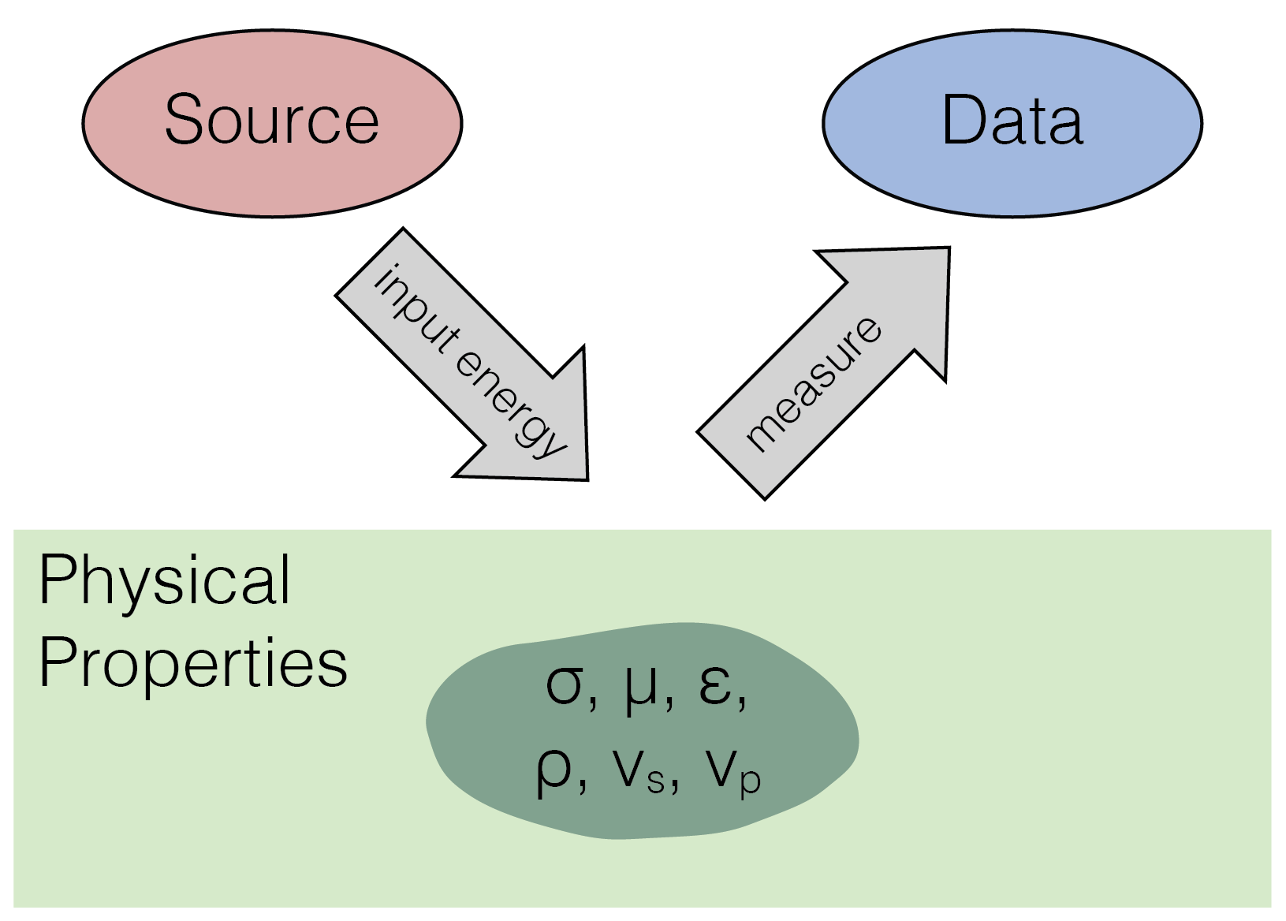
basic geophysical experiment

Slide 5
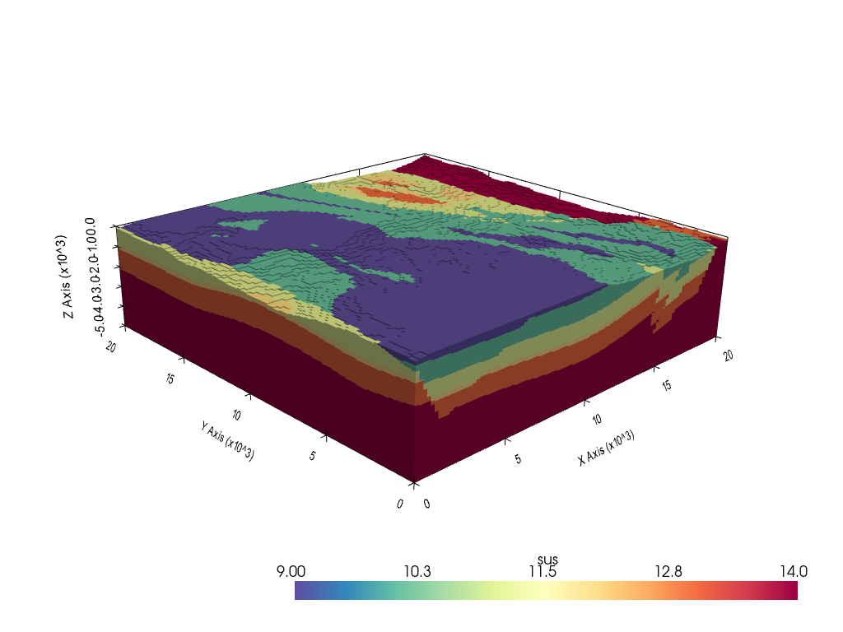
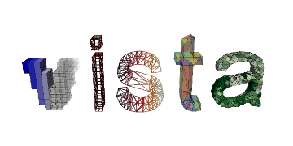

connecting geology and geophysics: why invert data?
Faults
Surficial soils
Bedrock
20 km
20 km
Example from Seogi Kang

Slide 6
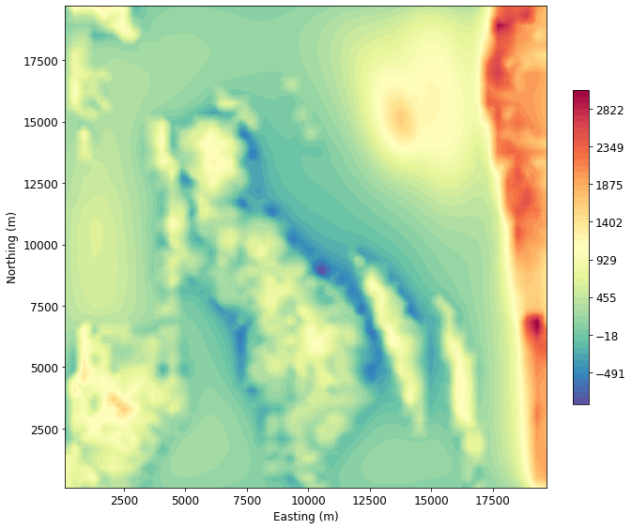
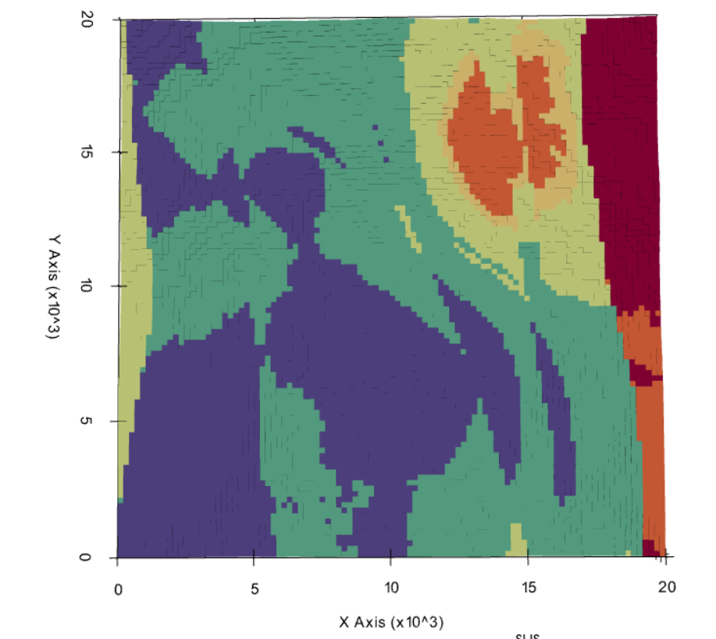
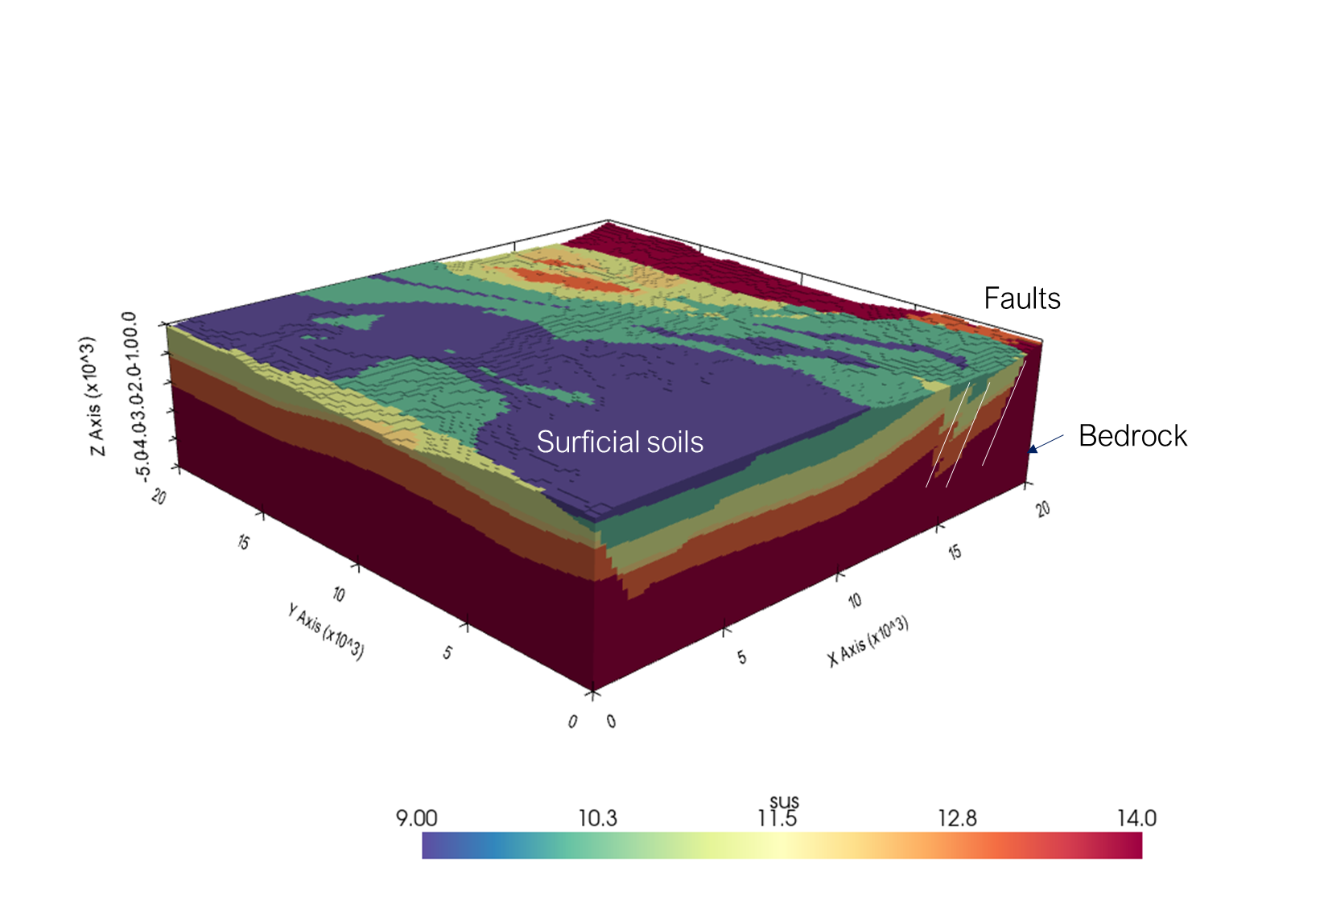
Measured magnetic data at I=90, D=0 (Magnetic pole)

Slide 7
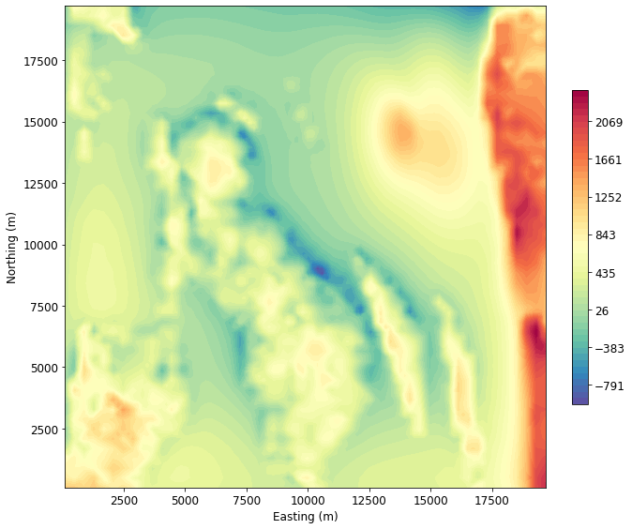
Measured magnetic data at I=66, D=-6 (California)

Slide 8
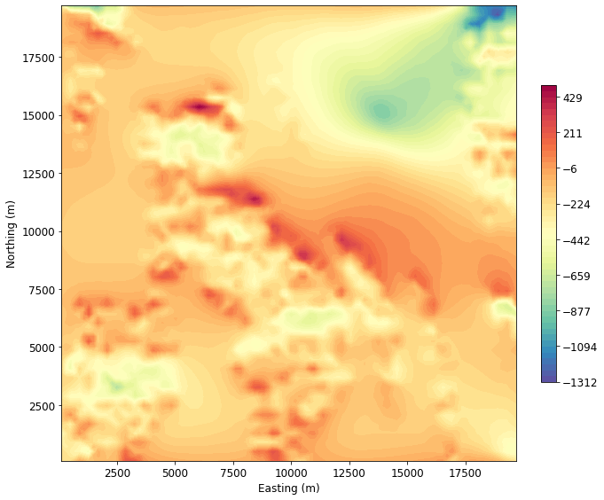
Measured magnetic data at I=0, D=0 (Equator)

Slide 9
Why invert data?
different source → different data (even for the same geology)
Pole (I=90, D=0)
California (I=66, D=-6)
Equator (I=0, D=0)

Slide 10
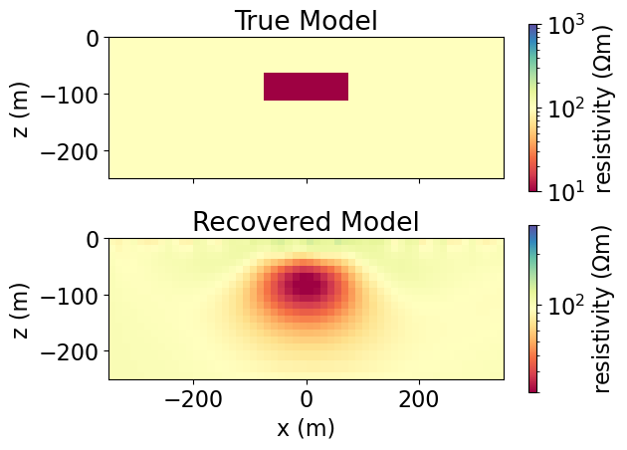
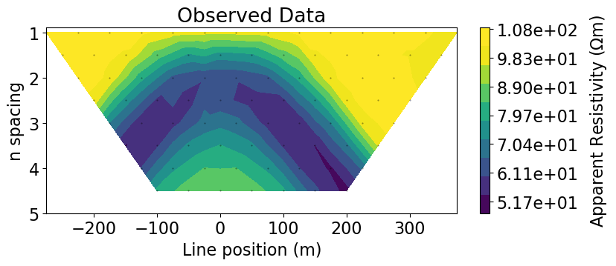
Why invert data?
data aren’t always interpretable directly

Slide 11
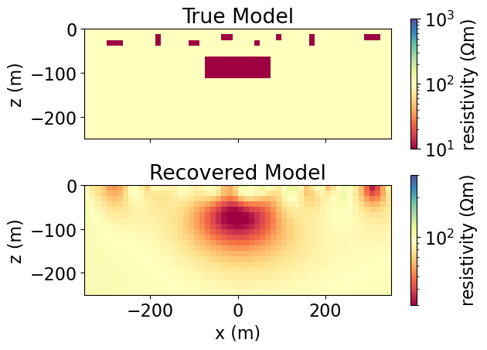
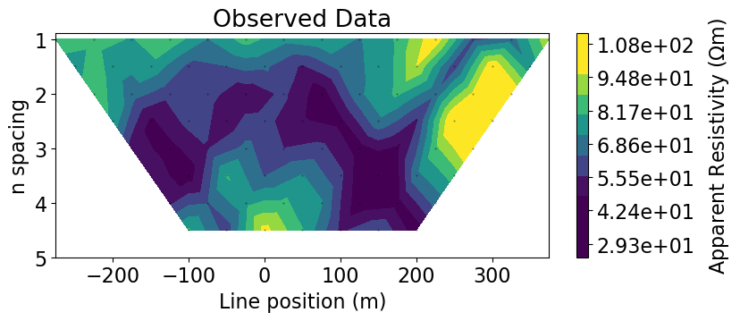
Why invert data?
data aren’t always interpretable directly

Slide 12
Why invert data?
data aren’t always interpretable directly

Slide 13
basic geophysical experiment
physical properties: connection point between geology and geophysics

Slide 14
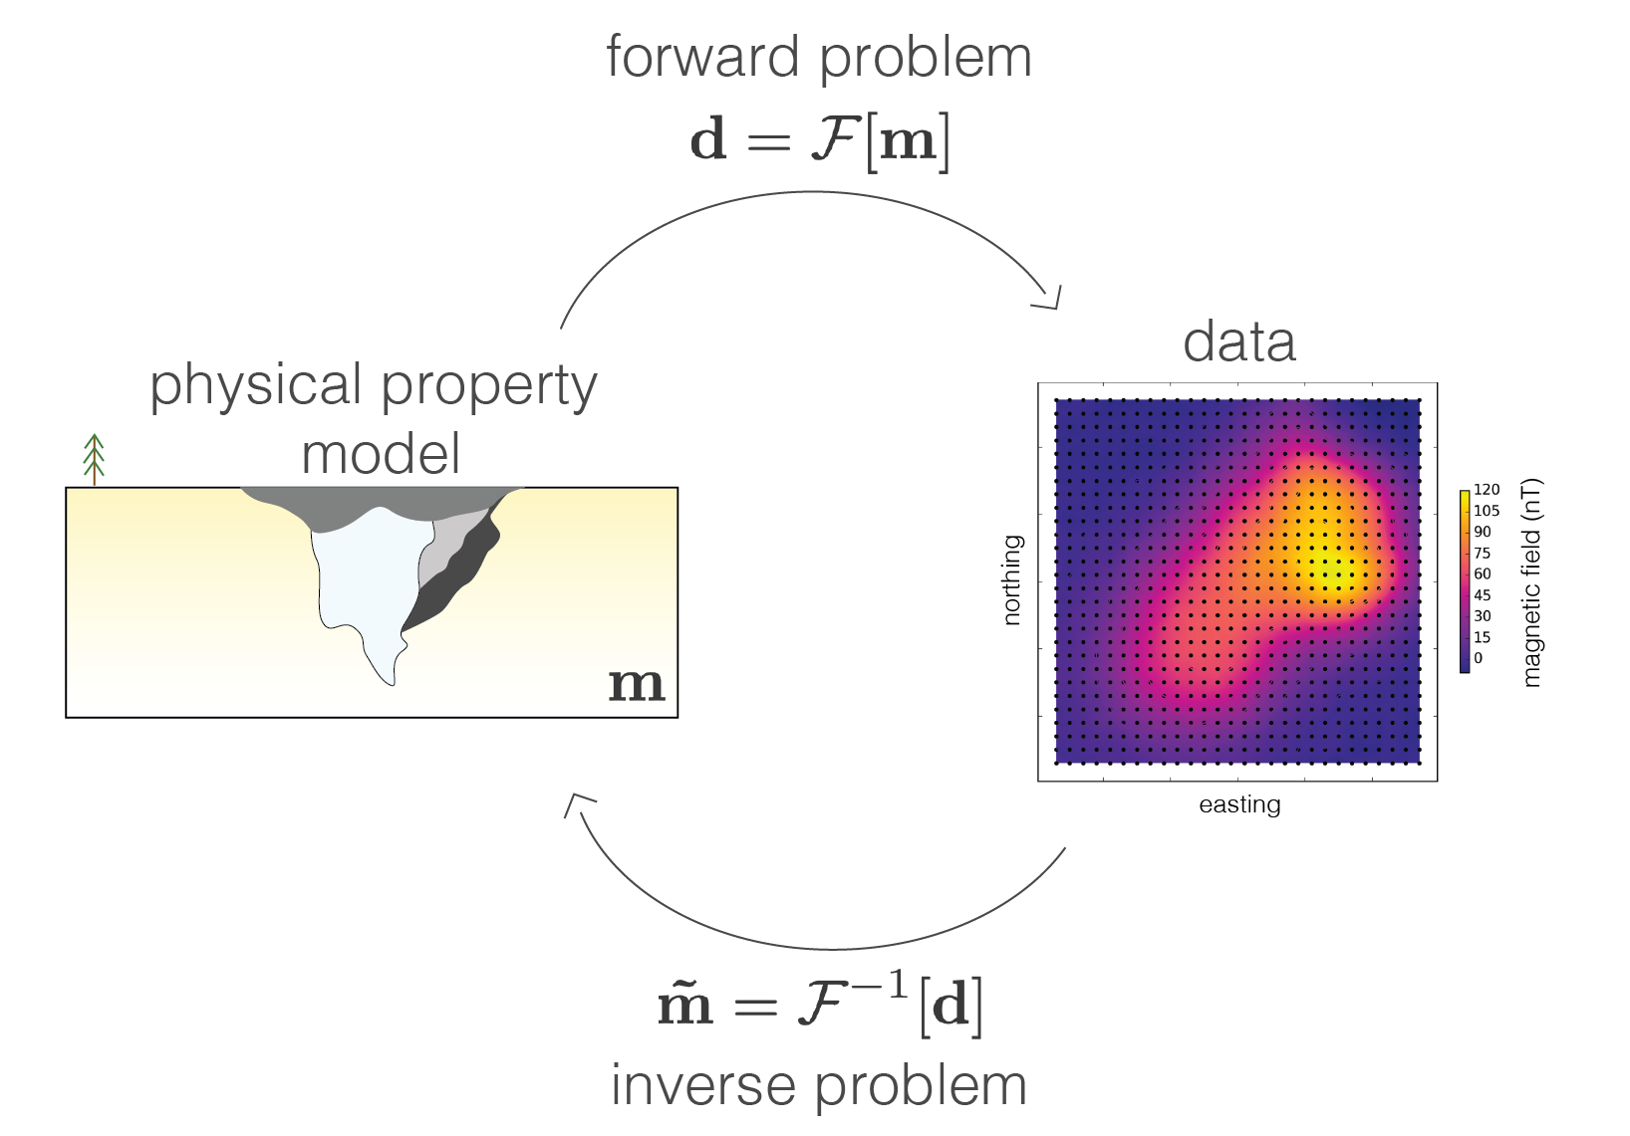
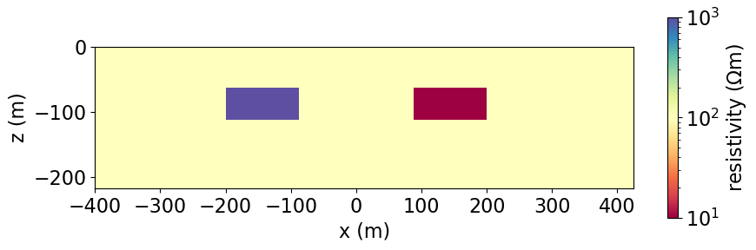
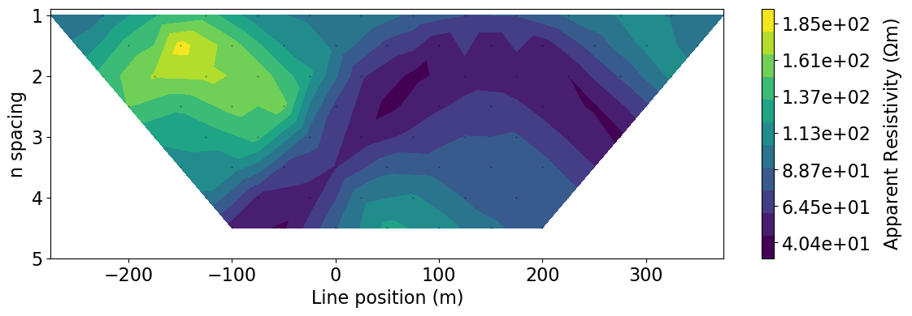
Forward and inverse problems

Slide 15
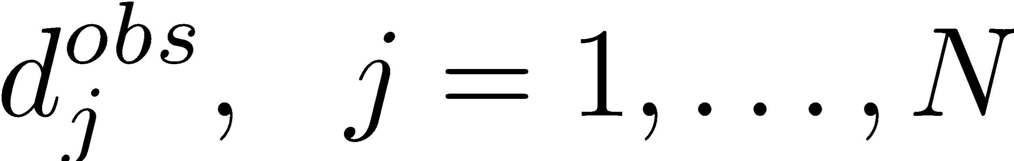
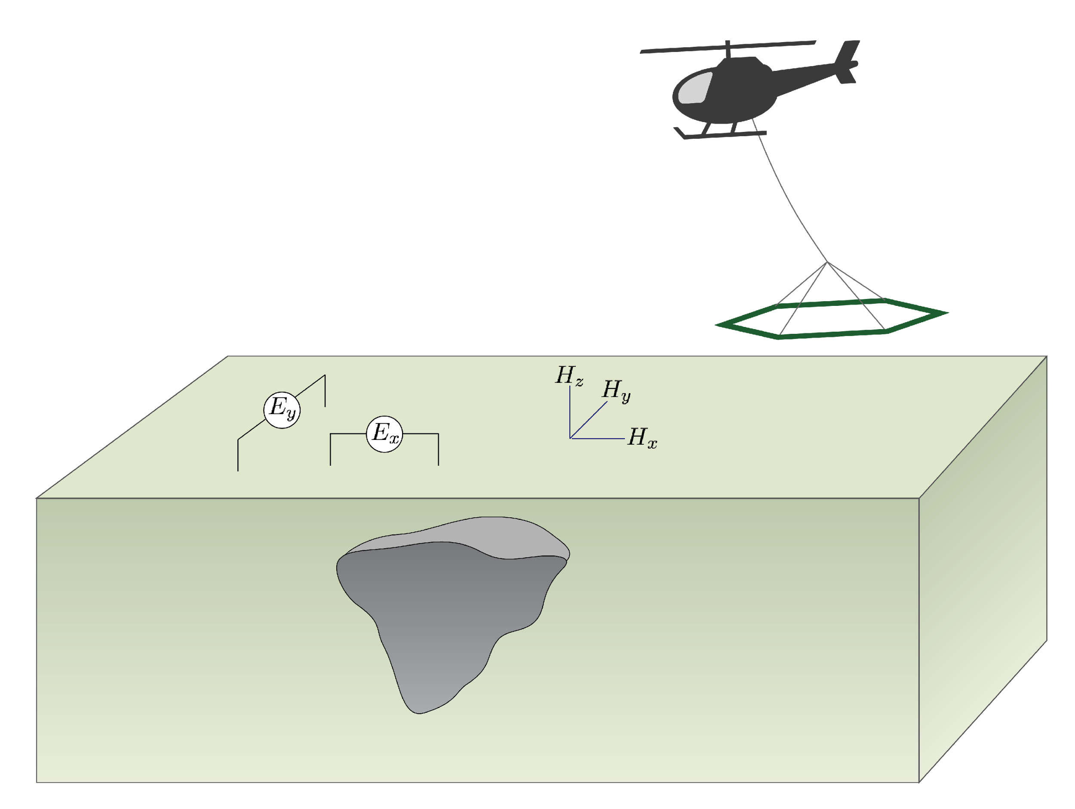
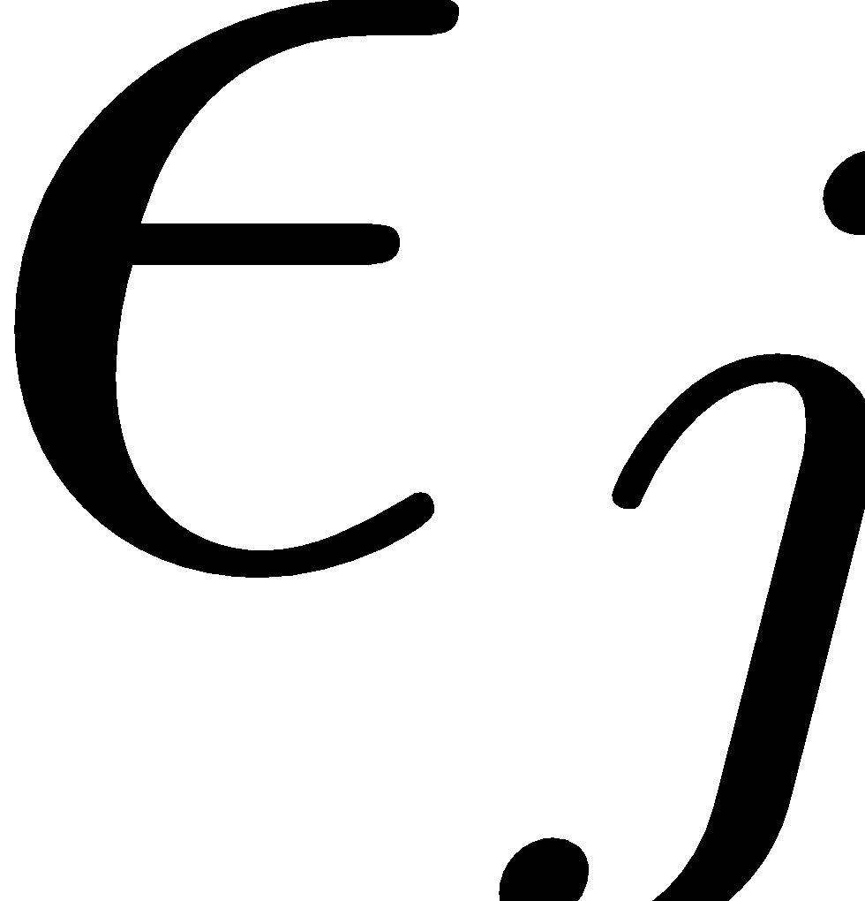
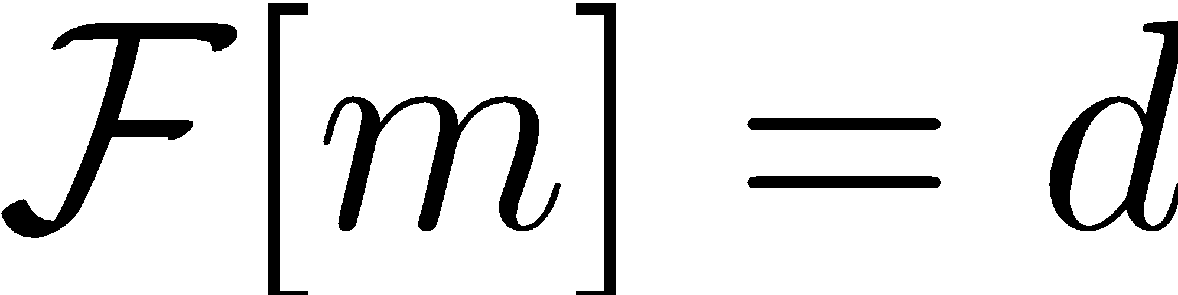
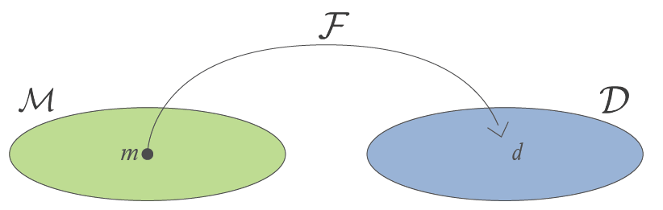
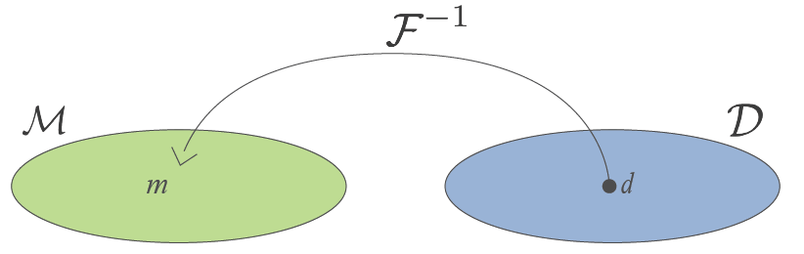
Statement of the inverse problem
Given
observations:
uncertainties:
ability to forward model:
Find the Earth model that gave rise to the data

Slide 16
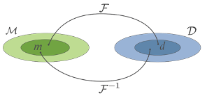
Inverse problems
The inverse problem is non-unique & ill-posed
Many models can fit the data
as an example of extreme non-uniqueness….
I
V

Slide 17
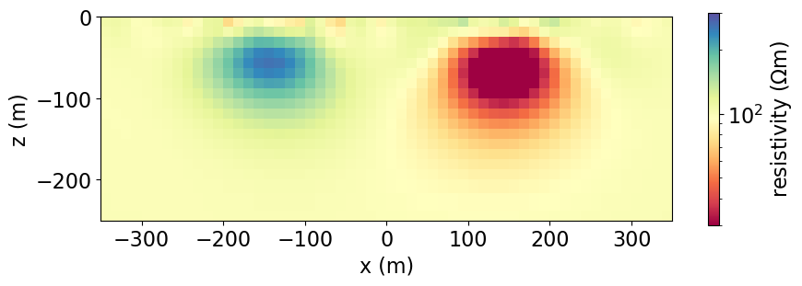
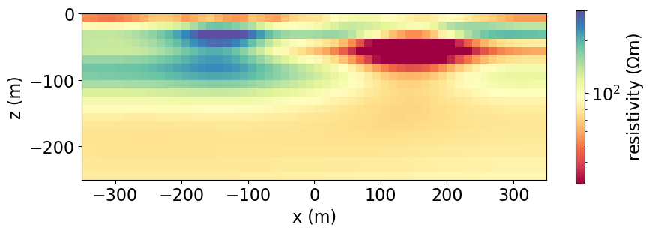
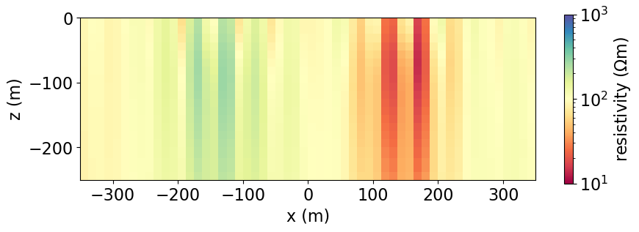
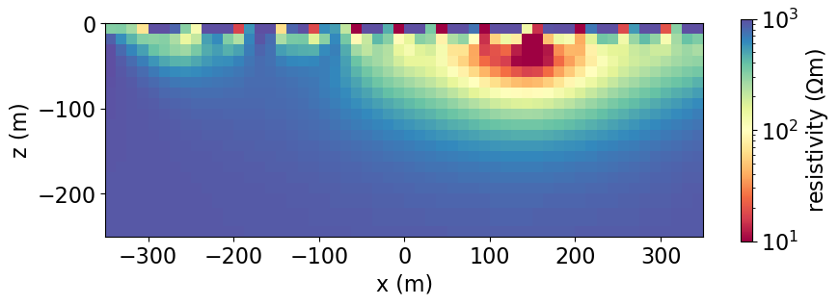
Inverse problems
extreme non-uniqueness… recovered models (all fit the data)
The inverse problem is non-unique & ill-posed
Many models can fit the data
I
V

Slide 18
Inverse problems
The inverse problem is non-unique & ill-posed
Many models of the subsurface can fit the data
any approach to the inverse problem must address these issues

Slide 19
Constraining the inversion
What information is available?
Geologic structure
Geologic constraints
Reference model
Bounds
Multiple data sets
Physical property measurements
Additional geophysical data
Prior information
Geophysical
data
Inversion
Physical property model

Slide 20
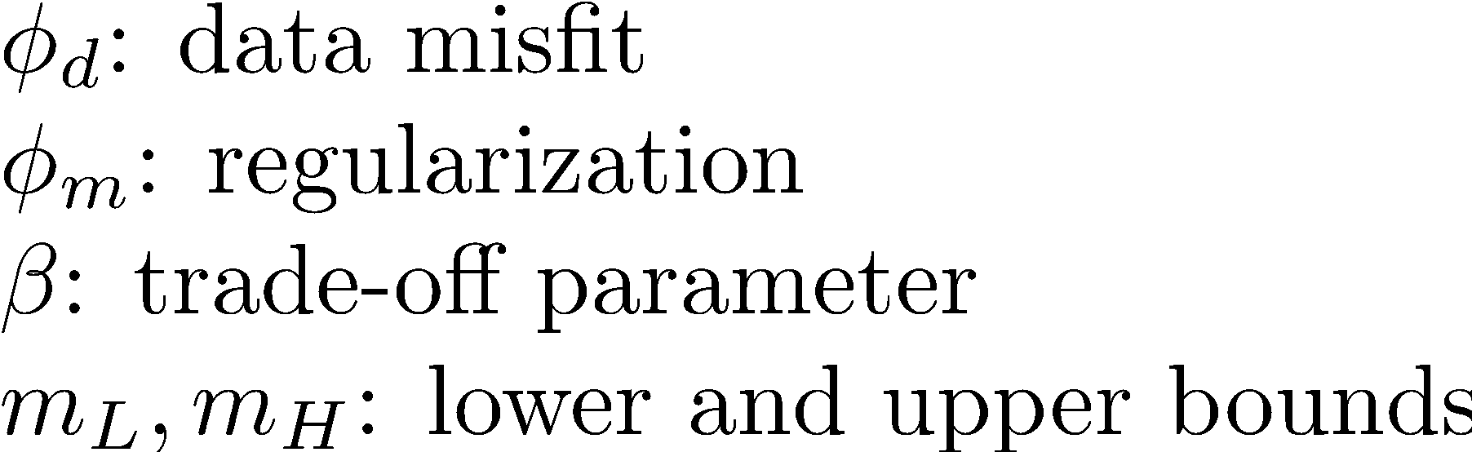
Our approach to the inverse problem
pose as an optimization problem
find a model
that fits the data
and respects prior knowledge
drill logs
geophysical logs (e.g. resistivity)
spatial patterns
other geophysical data
…

Slide 21
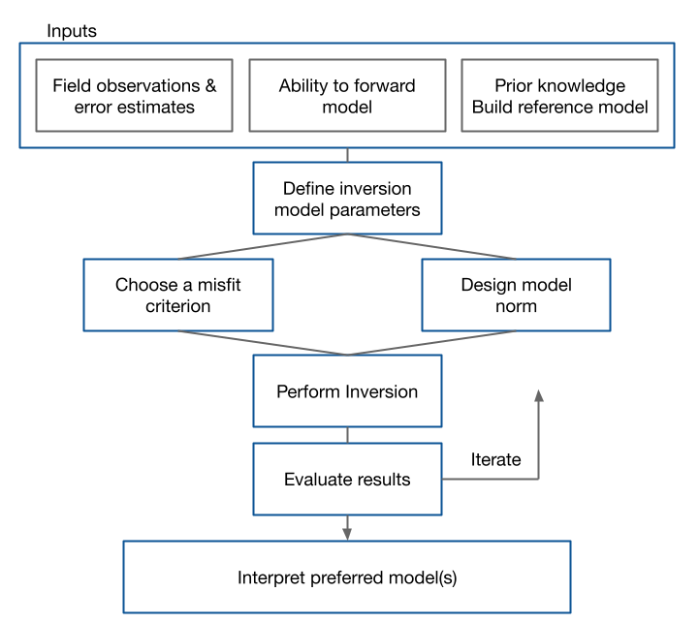
Flowchart for the inverse problem
How do we solve our problem?
Many components to achieving a quality result
Success is in the details
Evaluate each step in the box critically before going on

Slide 22
Starting up
Survey and observations
What processing has been done?
Ability for forward model
Assemble geologic, petrophysical information
Build a reference model
What is the question you want answered from the inversion?

Slide 23
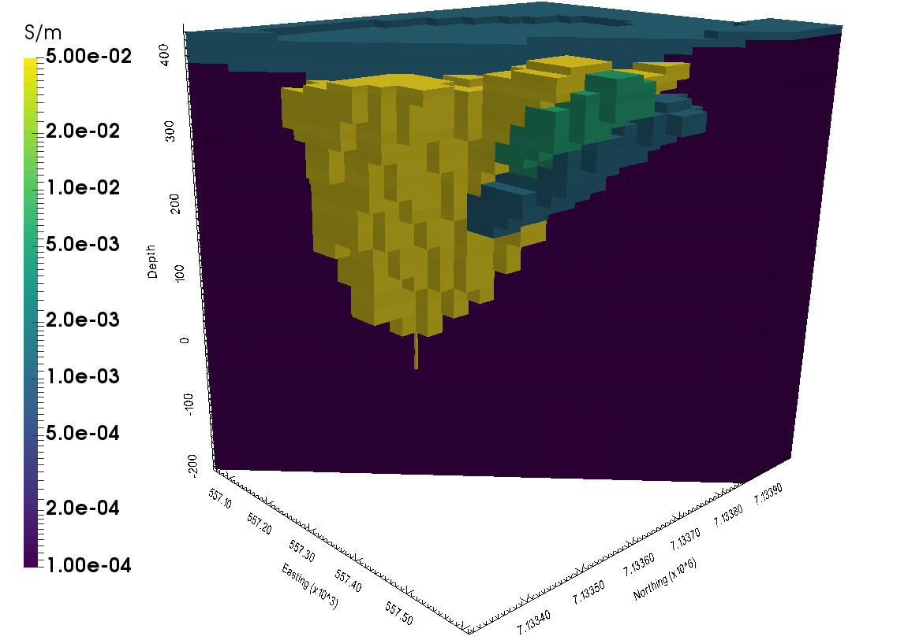
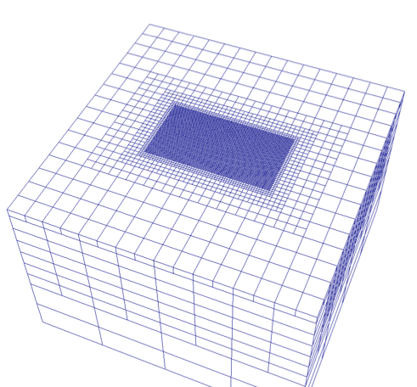
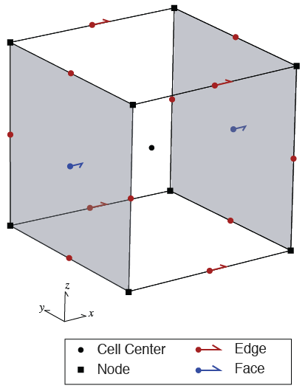
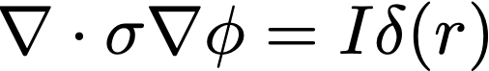
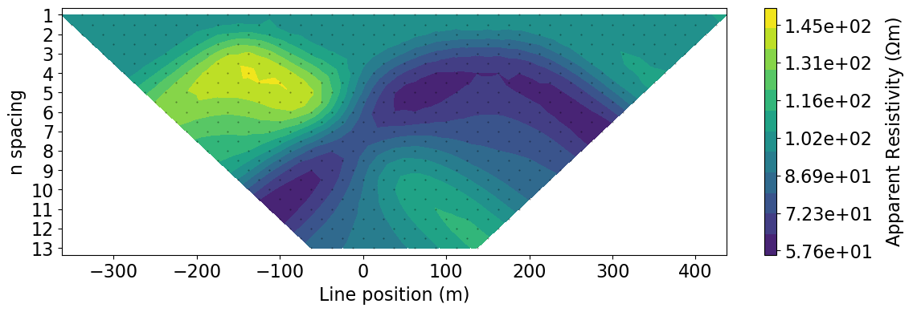
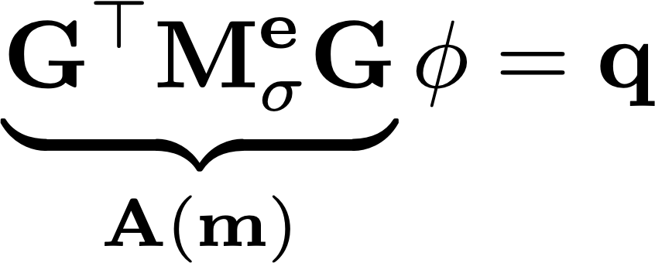
forward modelling
physical property model
Given a model of the earth → simulate data
General approach
“discretize” the subsurface
assign physical properties to each cell
solve discrete version of governing equations
governing equation
simulated data
discretized equations

Slide 24
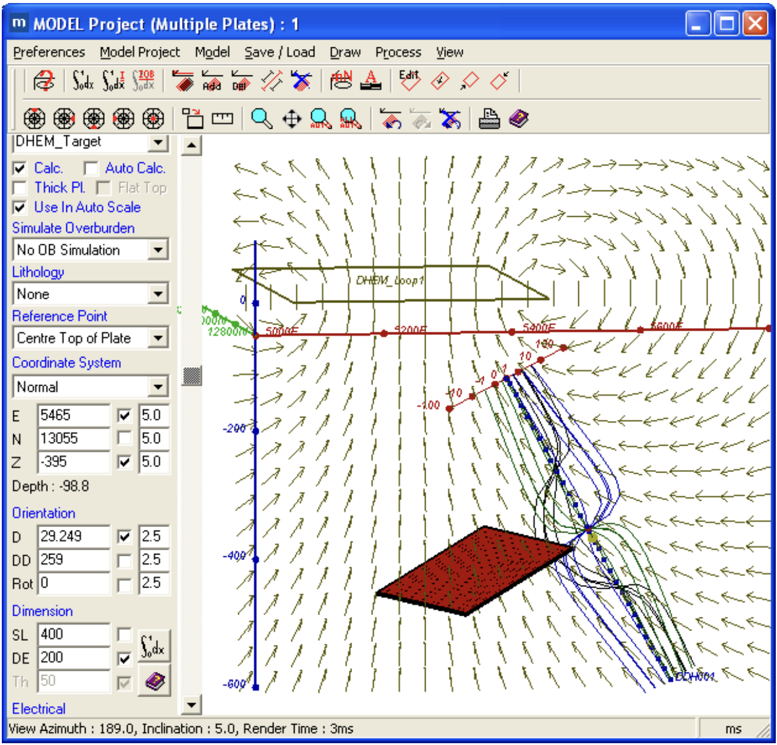
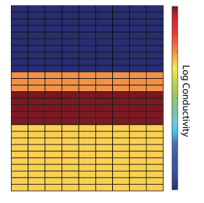
inversion model parameters
identify relevant physical properties
define parameters to invert for
have flexibility: log conductivity, layered earth, parametric….

Slide 25
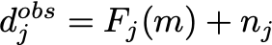
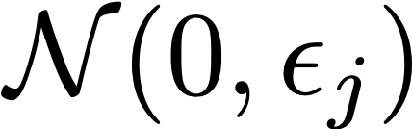
fitting the data
Observed data
Noise includes…
instrument / sensor noise
cultural noise, powerlines, wind, …
inaccuracies in survey parameters
modelling errors
dimensionality errors (1D v. 3D)
incomplete physics
discretization errors
True statistics of noise is complicated. In practice, assume Gaussian errors

Slide 26
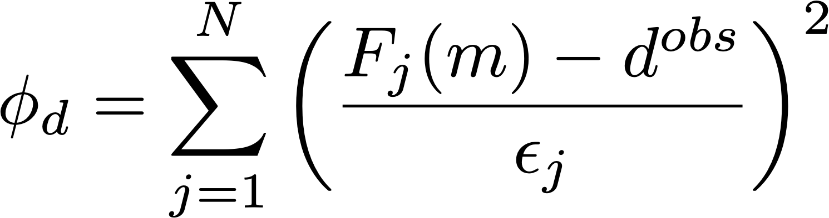
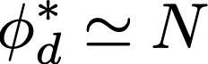
fitting the data
Observed data
Define a metric for data fit that lets us include information about uncertainties
data adequately fit when
difference: predicted and observed data
weighted by uncertainties
number of data

Slide 27
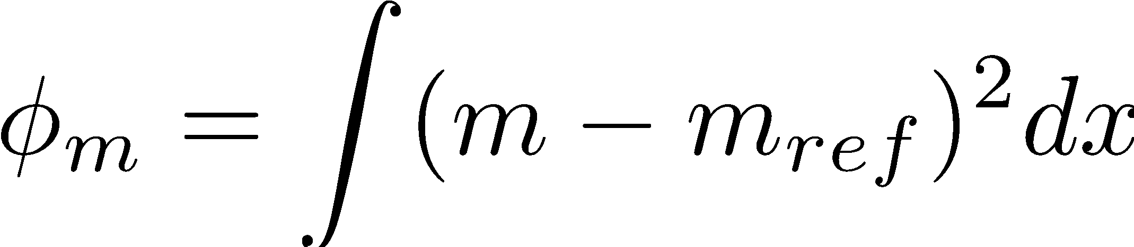
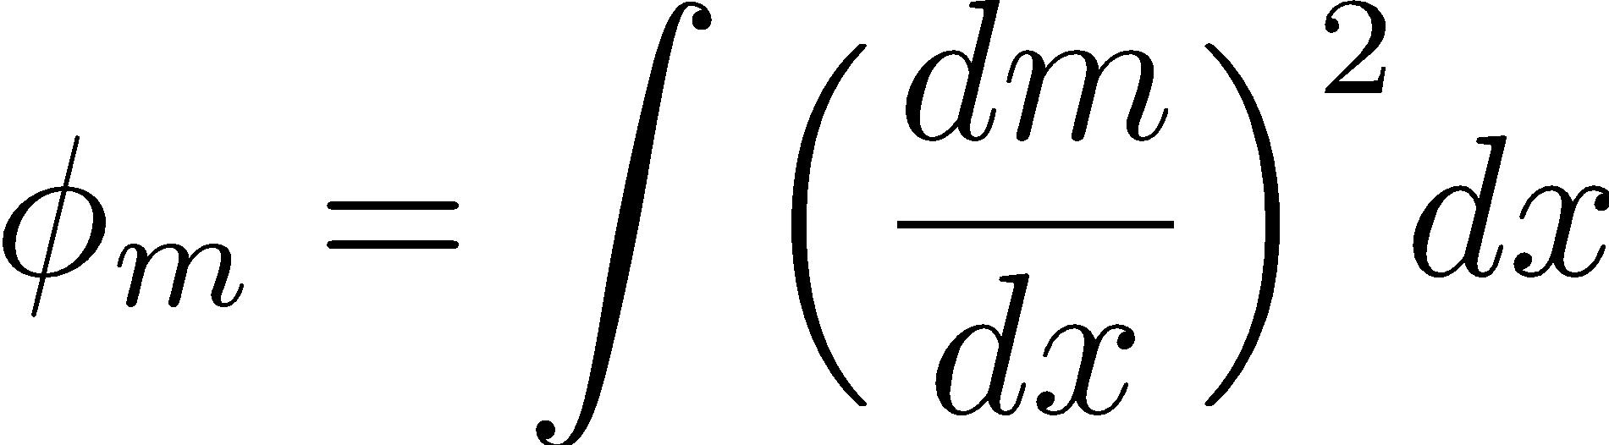
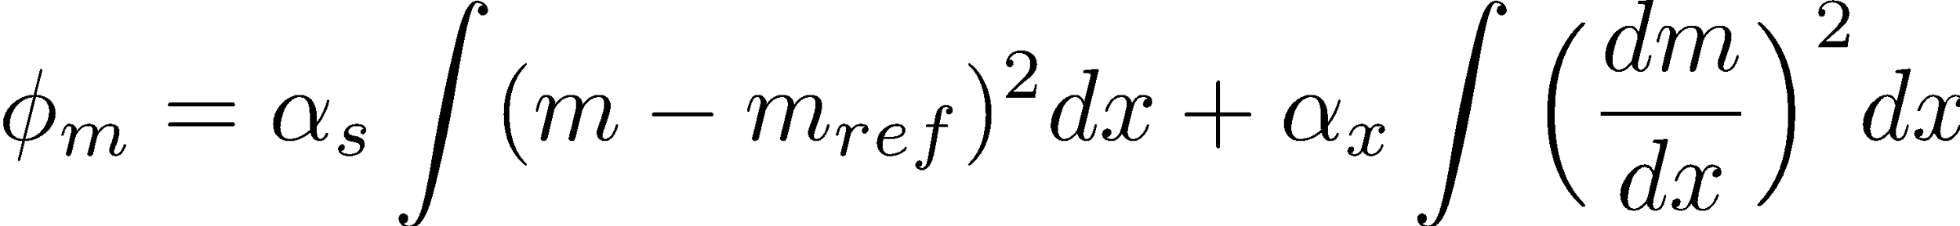
defining a model norm
bring in priori knowledge, assumptions
smallest model: favor model close to a reference model
smooth model: penalize large changes spatially
combination

Slide 28
running the inversion
Combine the pieces of the inversion
Choosing beta?
An example…

Slide 29
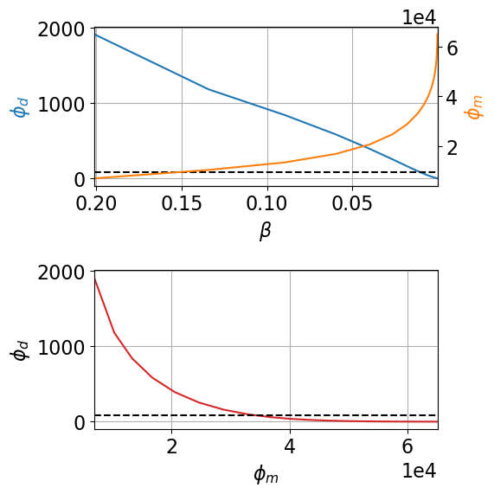
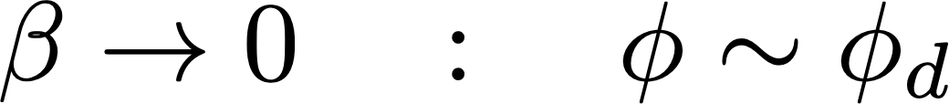



Role of
Influence of trade off parameter
Visualize influence with Tikhonov Curve
Desired misfit
Choose such that
large
small

Slide 30



Role of
Large : under fit

Slide 31



Role of
Small : over fit

Slide 32



Role of
: just right!

Slide 33
Flowchart for the inverse problem
How do we solve our problem?
often requires multiple inversions to obtain model for interpretation
iteratively update design of model norm, noise estimates, …
use geologic knowledge, common features in multiple inversion to build confidence in results

Slide 34



Case study: Mt. Isa
The Cluny copper/lead/zinc deposit, Queensland, Australia
Seven step framework for geophysics
gpg.geosci.xyz

Slide 35

Setup
The Cluny copper/lead/zinc deposit, Queensland, Australia
Geological model
Question: Can conductive units, which would be potential targets within the siltstones, be identified with DC?

Slide 36

Properties
expect mineralized zones to be conductive
do you anticipate any challenges?

Slide 37



Survey
data set 1: pole-dipole
8 survey lines, 2 configurations
mS/m
Easting (m)
Easting (m)

Slide 38


Survey
data set 2: dipole-pole
8 survey lines, 2 configurations
mS/m

Slide 39


Processing and interpretation
invert to obtain resistivity model

Slide 40


Synthesis
3D resistivity model
Geologic section
Resistivity section

Slide 41
Synthesis
3D resistivity model
Geologic section
Identified a major conductor → black shale unit
Some indication of a moderate conductor
Resistivity section

Slide 42

Can IP help?
Additional physical property: chargeability
Do you expect mineralization (disseminated sulfides) to be chargeable?

Slide 43

Survey and Data
IP data collected at same time as DC

Slide 44

Processing: two step process
DC data
IP data
Resistivity model (ρ)
Chargeability model (η)

Slide 45
Interpretation
A: Surprise creek (low σ, low η)

Slide 46
Interpretation
A: Surprise creek (low σ, low η)
B: Moondarra, Native Bee siltstones (moderate σ, low η)

Slide 47
Interpretation
A: Surprise creek (low σ, low η)
B: Moondarra, Native Bee siltstones (moderate σ, low η)
C and D: Breakaway shales (high σ, low η)

Slide 48
Interpretation
A: Surprise creek (low σ, low η)
B: Moondarra, Native Bee siltstones (moderate σ, low η)
C and D: Breakaway shales (high σ, low η)
E and F: Mt. Novit horizon (high σ, high η)

Slide 49
Interpretation
A: Surprise creek (low σ, low η)
B: Moondarra, Native Bee siltstones (moderate σ, low η)
C and D: Breakaway shales (high σ, low η)
E and F: Mt. Novit horizon (high σ, high η)
G: Possible mineralization (high σ, high η)

Slide 50
Mt. Isa: Synthesis
Chargeability delineates region of interest from background
Mt. Novit horizon is chargeable
Chargeability delineates Breakaway shale (high σ, low η) from mineralization (high σ, high η)

Slide 51
Summary
Inversions are a tool for estimating physical property models from geophysical data
Iterative process, requires assessing, updating assumptions and parameter choices
Constrain with prior knowledge, additional data
Prior information
Geophysical
data
Inversion
Physical property model

Slide 52


role of open-source tools
Inversions require ability to:
simulate equations
design model norm, data misfit
perform optimization
experiment with new ideas!
open source project for simulation and inversion of geophysical data
collaborative, community driven
https://simpeg.xyz

Slide 53







open educational resources
https://geosci.xyz
undergrad at UBC
electromagnetics course: 26 locations worldwide
Notes:
30k users for EM geosci, 25k for GPG

Slide 54




Thank you!
geosci.xyz
simpeg.xyz
lheagy@eoas.ubc.ca

